Slide 1
AZ-900T0x Module 02: Core Azure services
Notes:
Adjust the cover for either AZ-900T00 or AZ-900T01.

Slide 2
Lesson 01: Learning objectives

Slide 3
Module 2 – Learning objectives
Understand and describe core Azure architectural components.
Understand and describe core Azure services and products.
Understand and describe Azure solutions.
Understand and describe Azure management tools.

Slide 4
Lesson 02: Core Azure architectural components

Slide 5
Regions
A region represents a collection of datacenters.
Provides flexibility and scale.
Preserves data residency.
Select regions close to your users.
Be aware of region deployment availability.
There are global services that are region independent.
Worldwide there are 54 regions representing 140 countries
Notes:
A list of regions and their locations is available at https://azure.microsoft.com/en-us/global-infrastructure/locations/

Slide 6
Region Pairs
Each Azure region is paired with another region.
Azure prefers at least 300 miles of separation between datacenters in a regional pair.
Some services provide automatic replication to the paired region.
In an outage, recovery of one region is prioritized out of every pair.
Azure system updates are rolled out to paired regions sequentially (not at the same time).
Paired regions are members of the same geography – except Brazil.
Region
North Central US​
East US​
West US 2​
US East 2​
Canada Central​
North Europe​
UK West​
Germany Central​
South East Asia​
East China​
Japan East​
Australia Southeast​
India South​
Brazil South (Primary)​
Region
South Central US​
West US​
West Central US​
Central US​
Canada East​
West Europe​
UK South​
Germany Northeast​
East Asia​
North China​
Japan West​
Australia East​
India Central​
South Central US ​
Notes:
A full list of region pairs is available at https://docs.microsoft.com/en-us/azure/best-practices-availability-paired-regions#what-are-paired-regions

Slide 7
Geographies
Discrete markets that preserve data residency and compliance boundaries.
Typically contain two or more regions.
Allow customers with specific data-residency and compliance needs to keep their data and applications in close proximity.
Categorized as Americas, Europe, Asia Pacific, Middle East, and Africa.
Notes:
A list of geography locations is available at : https://azure.microsoft.com/en-us/global-infrastructure/geographies/

Slide 8
Availability Options
VM SLA
VM SLA
VM SLA
MULTI-REGION DISASTER RECOVERY
99.9% with Premium Storage
99.95%
99.99%
Region 1
Region 2
SINGLE VM
AVAILABILITY SETS
AVAILABILITY ZONES
REGION PAIRS
Easier lift and shift
Protecting against failures within datacenters
Protection from entire datacenter failures
Regional protection within Data Residency Boundaries
Notes:
This slide is to introduce the upcoming topics. You could also use the slide at the end of the lesson to review.

Slide 9
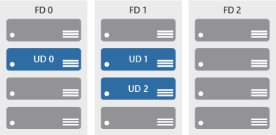
Availability sets
Keep applications online during maintenance or hardware failure.
Update domains (UD): Scheduled maintenance, performance or security updates are sequenced through update domains.
Fault domains (FD): Provide a physical separation of workloads across different hardware in a datacenter.

Slide 10

Availability zones
Azure Region
Physically separate locations within an Azure region.
Takes availability sets to the next level
Includes one or more datacenters, equipped with independent power, cooling, and networking.
Acts as an isolation boundary.
If one availability zone goes down, the other continues working.
Availability Zone 1
Availability Zone 2
Availability Zone 3
Notes:
More details about Availability Zones in Azure are available at https://docs.microsoft.com/en-us/azure/availability-zones/az-overview

Slide 11
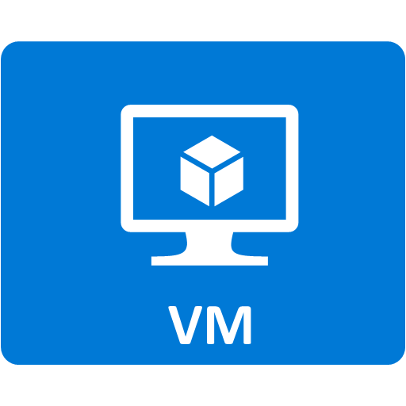


Resource groups
Resource groups (web + DB, VM, Storage) in one group
Containers for multiple resources that share the same life cycle.
Aggregates resources into a single manageable unit.
Every Azure resource must exist in one (and only one) resource group.
Secure at the resource group (or resource) level - using role-based access control (RBAC).
OR
Web and DB resource group
Virtual machine resource group
Storage resource group

Slide 12
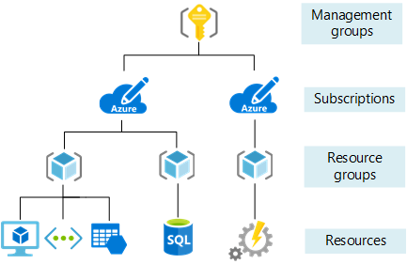
Azure Resource Manager
Provide a management layer that enables you to create, update, and delete resources in your Azure subscription.
Create, configure, manage and delete resources and resource groups.
Organize resources.
Control access and resources.
Automate using different tools and SDKs.
Notes:
You can view more details about Azure Resource Manager at https://docs.microsoft.com/en-us/azure/azure-resource-manager

Slide 13
Lesson 03: Core Azure services and products
Notes:
Consider covering the Azure Management Tools slide before you do any of the walkthroughs. This slide is in Lesson 05.

Slide 14
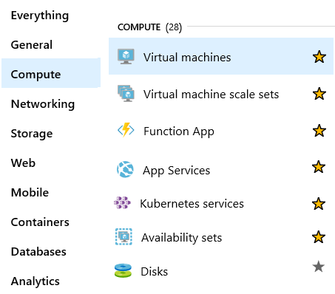
Azure compute
On-demand computing service for running cloud-based applications.
Provides computing resources such as disks, processors, memory, networking, and operating systems.
Makes resources available in minutes or seconds.
Lots of on-demand services.
Pay-per-use.
Notes:
For a full list of compute services available with Azure and the context on when to use them, visit https://azure.microsoft.com/en-us/product-categories/compute/

Slide 15

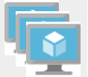


Azure compute services
Azure VMs use Infrastructure as a Service (IaaS) to provide computing power in the cloud.
VM scale sets are designed for automatic scaling of identical VMs.
App services is a Platform as a Service (PaaS) offering to build, deploy, and scale enterprise-grade web, mobile, and API apps.
Functions perform compute actions based on an event
.
Notes:
Azure virtual machines - https://azure.microsoft.com/en-us/services/virtual-machines/
Virtual machine scale sets - https://azure.microsoft.com/en-us/services/virtual-machine-scale-sets/
App services - https://azure.microsoft.com/en-us/services/app-service/
Azure Functions - https://azure.microsoft.com/en-us/services/functions/

Slide 16
Walkthrough - Create a virtual machine
Create a virtual machine in the Azure Portal, connect to the virtual machine, install the web server role and test.
Create the virtual machine.
Connect to the virtual machine.
Install the web server role and test.
Notes:
You can use this as a demonstration, have the students step through the tasks together, or have the students try it themselves.

Slide 17
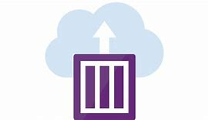

Container services
Containers are a virtualization environment. However, unlike virtual machines, you do not manage an operating system. Containers are meant to be lightweight, and are designed to be created, scaled out, and stopped dynamically.
Azure Container Instances: A PaaS offering that allows you to upload your containers, which it then will run for you.
Azure Kubernetes Service: A container orchestrator service for managing large numbers of containers.
Notes:
Azure Container Instances - https://azure.microsoft.com/en-us/services/container-instances/
Azure Kubernetes Service - https://azure.microsoft.com/en-us/services/kubernetes-service/

Slide 18
Walkthrough - Deploy Azure Container Instances
Using the Azure Portal create, configure, and deploy a Docker container to an Azure Container Instance. The container will deploy a Hello HTML page.
Create a container instance.
Deploy the container and test.
Notes:
You can use this as a demonstration, have the students step through the tasks together, or have the students try it themselves.

Slide 19





Azure network services
Azure Virtual Network provides secure communication between Azure resources.
Azure Load Balancer automatically scales to create highly-available access to applications or resources.
VPN Gateway is a platform managed scalable and highly available application delivery controller.
Azure Application Gateway provides for the management of traffic to web applications.
Content Delivery Network provides a distributed network of servers that efficiently deliver web content in their local region.
Notes:
Virtual Networks - https://azure.microsoft.com/en-us/services/virtual-network/
Azure Load Balancer - https://azure.microsoft.com/en-us/services/load-balancer/
VPN gateway - https://azure.microsoft.com/en-us/services/vpn-gateway/
Azure Application Gateway - https://azure.microsoft.com/en-us/services/application-gateway/
Content Delivery Network - https://azure.microsoft.com/en-us/services/cdn/
Networking - https://azure.microsoft.com/en-us/product-categories/networking/

Slide 20
Walkthrough - Create a virtual network
Create a virtual network with two virtual machines and then test connection between the machines.
Create a virtual network.
Create two virtual machines.
Test the connection.
Notes:
You can use this as a demonstration, have the students step through the tasks together, or have the students try it themselves.

Slide 21
Azure data categories
 | Schema | Data relationships | Examples
Structured data | Adheres to a schema, with the same data fields or properties. | Storable in relational database tables, with rows and columns. | Sensor data and financial data.
Semi-structured data | Has an ad hoc schema with less organized fields and properties. | Non-relational or NoSQL data, not storable in tables, rows and column. | Books, blogs, JSON, HTML documents.
Unstructured data | Has no designated schema or data structure. | Non-relational or blob data, with no restrictions on the kinds of data blobs contain. | PDFs, JPGs, videos.
Notes:
There are Azure products to support each data category.

Slide 22
Azure storage services
IaaS
PaaS
Disks
Persistent disks for Azure IaaS VMs.
Premium Storage.
Disks option: SSD based, high IOPS, low latency.
Lift and shift operations.
Files
SMB and REST access.
Access from anywhere.
Secure access.
Containers
Unstructured data – text or binary.
Block Blobs.
Page Blobs.
Append Blobs.
Tables
NoSQL data store - structured data.
Dynamic scaling based on load.
Scales to petabytes of data.
Fast key/value lookups.
Queues
Store and retrieve messages.
Highly scalable.
Messages can be processed asynchronously.
Built on an unified distributed storage system
Durability, Encryption at rest, Strongly consistent replication, fault tolerance, auto load-balancing
Notes:
Storage services - https://azure.microsoft.com/en-us/product-categories/storage/

Slide 23
Walkthrough - Create Blob storage
Create a storage account with a blob storage container. Work with blob files.
Create a storage account.
Work with blob storage.
Monitor the storage account.
Notes:
You can use this as a demonstration, have the students step through the tasks together, or have the students try it themselves.

Slide 24

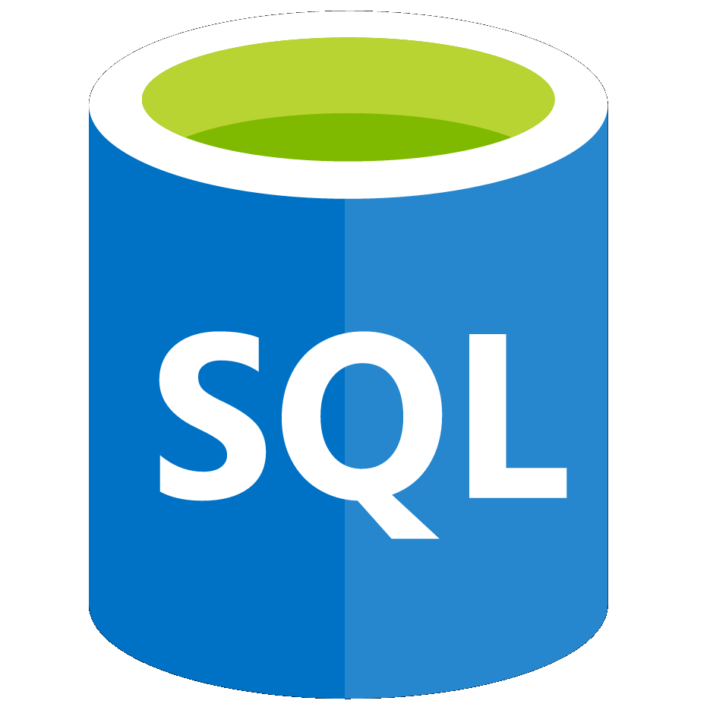
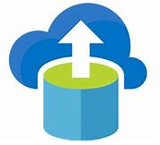
Azure database services
Azure Cosmos DB is a globally-distributed database service that enables you to elastically and independently scale throughput and storage.
Azure SQL Database is a relational database as a service (DaaS) based on the latest stable version of the Microsoft SQL Server database engine.
Azure Database Migration is a fully-managed service designed to enable seamless migrations from multiple database sources to Azure data platforms with minimal downtime.
These are just a few of our database offerings.
Notes:
✔️ These are just a few of our database service offerings. Take a minute to review other database services and [find the product you need](https://azure.microsoft.com/en-us/product-categories/databases/).
Azure Cosmos DB - https://azure.microsoft.com/en-us/services/cosmos-db/
Azure SQL Database - https://azure.microsoft.com/en-us/services/sql-database/
Azure Database Migration Service - https://azure.microsoft.com/en-us/services/database-migration/

Slide 25
Walkthrough-Create a SQL database
Create a SQL database in Azure and then query the data in that database.
Create the database.
Query the database.
Notes:
You can use this as a demonstration, have the students step through the tasks together, or have the students try it themselves.

Slide 26

Azure Marketplace
Connects end users with Microsoft partners, Independent Software Vendors (ISVs), and start-ups that offer solutions and services for Azure.
Azure customers, IT professionals and cloud developers can find, try, purchase, and provision Azure applications and services from certified service providers.
Includes close to 10,000 product listings.
Notes:
There is also a Marketplace FAQ available at https://azure.microsoft.com/en-us/marketplace/faq/
Azure Marketplace - https://azuremarketplace.microsoft.com/en-us/

Slide 27
Lesson 04: Azure solutions

Slide 28


Internet of Things
Azure IoT Central is a fully-managed global IoT SaaS solution that makes it easy to connect, monitor, and manage your IoT assets at scale.
Azure IoT Hub is a managed service hosted in the cloud that acts as a central message hub for bidirectional communication between your IoT application and the devices it manages.
These are just two of our IoT offerings. Use the IoT Product Selector to determine which product is best for your situation.
Notes:
These are just two of our IoT offerings. Use the IoT Product Selector to determine what product is best for your situation - https://azure.microsoft.com/en-us/overview/iot/product-selector/
IoT Central - https://docs.microsoft.com/en-us/azure/iot-central/
Azure IoT Hub - https://docs.microsoft.com/en-us/azure/iot-hub/
For a full list of IoT-related services available with Azure, and for context on when you use them, see the page https://azure.microsoft.com/en-us/overview/iot/

Slide 29
Walkthrough - Implement the Azure IoT Hub
Create an Azure IoT Hub in Azure Portal and configure the hub to authenticate a connection to an IoT device using the Raspberry Pi device simulator.
Create an IoT Hub.
Add an IoT device.
Test the device using the Raspberry Pi Simulator.
Notes:
You can use this as a demonstration, have the students step through the tasks together, or have the students try it themselves.

Slide 30
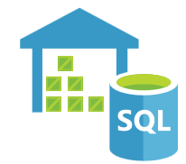

Big data and analytics
Azure SQL Data Warehouse is a cloud-based Enterprise Data Warehouse that leverages massively parallel processing to run complex queries quickly across petabytes of data.
Azure HDInsight is a fully-managed, open-source analytics service for enterprises. It is a cloud service that makes it easier, faster, and more cost-effective to process massive amounts of data.
Azure Data Lake Analytics is an on-demand analytics job service that simplifies big data. Instead of deploying and tuning hardware, you write queries to transform your data and extract valuable insights.
Notes:
Azure SQL Data Warehouse - https://azure.microsoft.com/en-us/services/sql-data-warehouse/
Azure HDInsight - https://azure.microsoft.com/en-us/services/hdinsight/
Azure Data Lake Analytics - https://azure.microsoft.com/en-us/services/data-lake-analytics/
Data and Analytics services - https://azure.microsoft.com/en-us/product-categories/analytics/

Slide 31


Artificial Intelligence
Azure Machine Learning service provides a cloud-based environment used to develop, train, test, deploy, manage, and track machine learning models.
Azure Machine Learning Studio is a collaborative, drag-and-drop visual workspace where you can build, test, and deploy machine learning solutions without needing to write code.
Notes:
Azure Machine Learning Service - https://azure.microsoft.com/en-us/services/machine-learning-service/
Azure Machine Learning Studio - https://azure.microsoft.com/en-us/services/machine-learning-studio/
Note: For a full list of Artificial Intelligence and Machine Learning services available with Azure, see the AI + Machine Learning section on the https://azure.microsoft.com/en-us/overview/ai-platform/ page.

Slide 32



Serverless computing
Azure Functions is code running your service and not the underlying platform or infrastructure. Creates infrastructure based on an event.
Azure Logic Apps is a cloud service that helps you automate and orchestrate tasks, business processes, and workflows when you need to integrate apps, data, systems, and services.
Azure Event Grid is a fully-managed, intelligent event routing service that uses a publish-subscribe model for uniform event consumption.
Notes:
Azure Functions - https://docs.microsoft.com/en-us/azure/azure-functions/
Azure Logic Apps - https://docs.microsoft.com/en-us/azure/logic-apps/
Azure Event Grid - https://docs.microsoft.com/en-us/azure/event-grid/
Note: For more details about serverless services available with Azure, see https://azure.microsoft.com/en-us/solutions/serverless/

Slide 33
Walkthrough - Implement Azure Functions
Create a Function app with a Webhook to provide a Hello message with your name.
Create a Function app.
Create a HTTP triggered event function and test.
Notes:
You can use this as a demonstration, have the students step through the tasks together, or have the students try it themselves.

Slide 34


DevOps
Azure DevOps services provides development collaboration tools including pipelines, Git repositories, Kanban boards, and extensive automated and cloud-based load testing.
Azure DevTest Labs allows you to quickly create environments in Azure while minimizing waste and controlling cost.
Notes:
Azure DevOps Services - https://docs.microsoft.com/en-us/azure/devops/
Azure DevTest Labs - https://azure.microsoft.com/en-us/services/devtest-lab/
Note: For more general details on DevOps services available with Azure, see https://docs.microsoft.com/en-us/azure/#pivot=products&panel=devops

Slide 35
Azure App Service
Quickly and easily build web and mobile apps for any platform or device.
Multiple languages and frameworks.
DevOps optimization.
Global scale with high availability.
Connections to SaaS platforms and on-premises data.
Security and compliance.
Application templates.
Visual Studio integration.
API and mobile features.
Serverless code.
Notes:
This slide provides a chance to talk about the App Service before the Web App walkthrough.

Slide 36
Walkthrough – Create a Web App
Create a new web app by using a Docker image stored in Azure Container Registry.
Create a Web App using a Docker image.
Test the Web App.
Notes:
You can use this as a demonstration, have the students step through the tasks together, or have the students try it themselves.

Slide 37
Lesson 05: Azure management tools

Slide 38






Azure management tools
Azure portal
Azure PowerShell and Azure Command-Line Interface (CLI)
Azure Cloud Shell
Azure mobile app
Azure REST API / Graph API

Slide 39
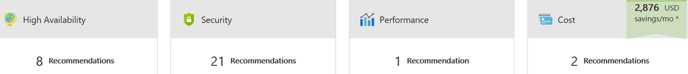

Azure Advisor
Analyzes your deployed Azure resources and recommends ways to improve availability, security, performance, and costs.
Get proactive, actionable, and personalized best practice recommendations.
Improve the performance, security, and availability of your resources.
Identify opportunities to reduce your Azure costs.
Notes:
Azure Advisor - https://docs.microsoft.com/en-us/azure/advisor/

Slide 40
Walkthrough – Create a VM with an ARM Template
Use the Azure QuickStart gallery to deploy a template that creates a virtual machine.
Explore the gallery and deploy a template.
Verify your virtual machine deployment.

Slide 41
Walkthrough - Create a VM with PowerShell
Install PowerShell locally, create a resource group and virtual machine, access and use the Cloud Shell, and review Azure Advisor recommendations.
Configure PowerShell locally.
Use PowerShell to create a resource group and virtual machine.
Execute PowerShell commands in the Cloud Shell.
Review Azure Advisor Recommendations.
Notes:
You can use this as a demonstration, have the students step through the tasks together, or have the students try it themselves.

Slide 42
Walkthrough - Create a VM with the Azure CLI
Install the Azure CLI locally, create a resource group and virtual machine, use the Cloud Shell, and review Azure Advisor recommendations.
Install the CLI locally.
Use the CLI to create a resource group and virtual machine.
Execute commands in the Cloud Shell.
Review Azure Advisor Recommendations.
Notes:
You can use this as a demonstration, have the students step through the tasks together, or have the students try it themselves.

Slide 43
Lesson 06: Module review questions
Notes:
As you have time go through the review questions in the student materials.

